Slide 1


New Students

Slide 2

By:
Dr.Suroor Moaid Dawood
Ph.D. In Electrical Eng.
BUOG
2022

Slide 3

Contents
AutoCAD Basics
Create New Drawing
Modifying Commands
Layers
Text and Dimensions
Isometric
3D Modeling
Printing
3 D Drawings

Slide 4


Slide 5
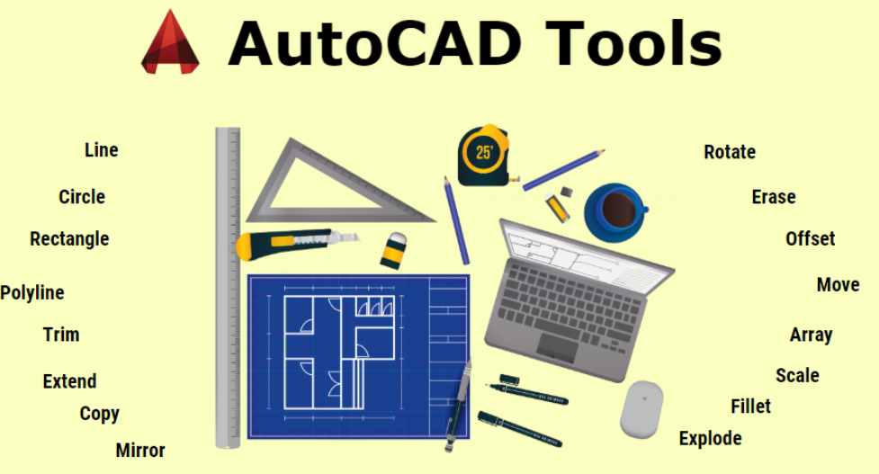

Slide 6



